Slide 1
AEM 2210
Financial Accounting
Chapter 10: Reporting and Interpreting Bond Securities
Professor Sinclair
Spring 2018

Slide 2
Chapter 10 Learning Objectives
Describe the characteristics of bond securities
Report bonds payable and interest expense for bond securities issued at par
Compute and analyze the times interest earned ratio
Report bonds payable and interest expense for bond securities issued at a discount
Report bonds payable and interest expense for bond securities issued at a premium
Compute and analyze the debt-to-equity ratio
Report the early retirement of bond securities
Explain how bond securities are reported on the statement of cash flows

Slide 3
Where we are on the Income Statement
Income Statement for FY 2016
Revenues | 1,000
COGS | (600)
Gross Profit | 400
SG&A | (305)
Operating Income | 95
Interest Expense | (16)
Other Income (Expense) | (4)
Gains (Losses) | 25
Earnings before Taxes | 100
Tax Expense | (35)
Net Income | 65
EPS | 0.065
Gain/Loss on Early Redemption of Bonds included here

Slide 4
Where we are on the Balance Sheet
Balance Sheet as of 12/31/2016
Assets |  |  | Liabilities
Cash | 200 |  | Accounts Payable | 100
Accounts Receivable, gross | 200 |  | Salaries Payable | 30
(Allow. For Doubtful Accounts) | (10) |  | Current Portion of LT Debt | 50
Investments in Other Companies | 100 |  | Other | 70
Inventory | 230 |  | Current Liabilities | 250
Prepaid Assets | 120
Current Assets | 840 |  | Warranty Liabilities | 20
 |  |  | Contingent Liabilities | 40
PP&E, gross | 1000 |  | Deferred Tax Liabilities, net | 80
(Accumulated Depreciation) | (250) |  | Capital Lease Obligation | 100
Intangibles, net | 150 |  | Bonds, net | 600
Long-term Assets | 900 |  | Long-term Liabilities | 840
 |  |  | Owners’ Equity
 |  |  | Common Stock | 50
 |  |  | APIC | 450
 |  |  | Treasury Stock | (10)
 |  |  | Other | 10
 |  |  | Retained Earnings | 150
 |  |  | Owners’ equity | 650
Total Assets | 1740 |  | Total Liabilities & OE | 1740

Slide 5
Capital Structure
Capital structure is the mixture of debt and equity a company uses to finance its operations.
Almost all companies employ some debt in their capital structure. Bonds are securities that corporations and governmental units issue when they borrow large amounts of money.
Large corporations need to borrow billions of dollars, which makes borrowing from individual creditors impractical. Instead, these corporations issue bonds to raise debt capital.
The ability to sell a bond on the bond exchange is a significant advantage for investors because it provides them with liquidity. By issuing more liquid debt that investors can easily buy and sell in the bond markets, companies are able to reduce the cost of long-term borrowing.

Slide 6
Bonds Payable

Slide 7
Bonds Payable
Companies have the choice to issue bonds or stock to raise needed capital. The choice is affected by a few advantages and disadvantages.
Advantages of bonds:
Stockholders maintain control because bonds are debt, not equity
Interest expense is tax deductible
The impact on earnings is positive because money can often be borrowed at a low interest rate and invested at a higher interest rate
Disadvantages of bonds:
Risk of bankruptcy exists because the interest and debt must be paid back as scheduled or else creditors may force legal action
Negative impact on cash flows exists because interest and principal must be repaid in the future

Slide 8
Bonds Payable
When a company issues its bonds, it specifies two types of cash payments in the bond contract:
Interest over its life
These payments, which represent an annuity, are computed by multiplying the principal amount and the interest rate (aka par value, contract rate, nominal rate) stated in the bond contract. The bond contract specifies whether the interest payments are made quarterly, semiannually, or annually.
Repayment of principal
This amount is usually a single payment that is made when the bond matures. It is also called the par value or face value. For most individual bonds, the par value is $1,000, but it can be any amount.
Neither the issuing company nor the underwriter determines the price at which the bonds sell. Instead, the market determines the price using present value concepts.

Slide 9
Bonds Payable
An indenture is a bond contract that specifies the legal provisions of a bond issue. The indenture also contains covenants designed to protect the creditors.
Different types of bonds have different characteristics for good economic reasons.
Individual creditors have different risk and return preferences. A retired person may be willing to receive a lower interest rate in return for greater security. This type of creditor might want a mortgage bond that pledges a specific asset as security in case the company cannot repay the bond. Another type of creditor might be willing to accept a low interest rate and an unsecured status in return for the opportunity to convert the bond into common stock at some point in the future.
Companies try to design bond features that are attractive to different groups of creditors. Some key types of bonds include:
Unsecured bond: no assets are specifically pledged to guarantee repayment at maturity
Secured bond: specific assets are pledged to guarantee repayment at maturity
Callable bond: may be retired early by the bond issuer
Convertible bond: may be converted to other securities (usually common stock) at the option of the bondholder

Slide 10
Bond Issuance

Slide 11
Bond Issuance Process
The bond issuer also prepares a prospectus, which is a regulatory filing that describes all the details of a debt or equity security to potential buyers.
When a company decides to issue new bonds, it prepares a bond indenture (bond contract) that specifies the legal provisions of the bonds. These provisions include the maturity date, rate of interest to be paid, date of each interest payment, and any conversion privileges. The indenture also contains covenants designed to protect the creditors. Typical covenants include limitations on new debt that the company might issue in the future, limitations on the payment of dividends, or requirements for certain minimum accounting ratios, such as the current ratio.
Because covenants may limit the company’s future actions, management prefers those that are least restrictive. Creditors, however, prefer more restrictive covenants, which lessen the risk of the investment. As with any business transaction, the final result is achieved through negotiation. Bond covenants are typically reported in the notes to the financial statements.
An independent party, called the trustee, is usually appointed to represent the bondholders. A trustee’s duties are to ascertain whether the issuing company fulfills all provisions of the bond indenture.

Slide 12
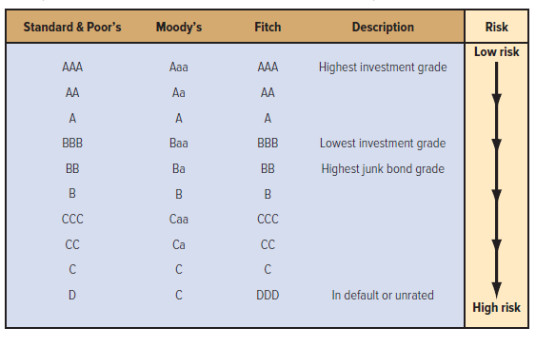
Bond Issuance Process
Because of the large amount of money involved and the complexities associated with bonds, several agencies exist to evaluate the risk that a bond issuer will not be able to meet the requirements specified in the prospectus.
This risk is called default risk. Higher-quality bonds have a lower default risk, while lower-quality bonds have a higher default risk.
Standard & Poor’s, Moody’s, and Fitch use letter ratings to specify the quality of a bond. Many banks, mutual funds, and trusts are permitted to invest only in investment-grade bonds.

Slide 13
Bond Issuance
The issue price of the bond is determined by the market, based on the time value of money.
Recall that there are two cash flow streams related to a bond: the principal and the interest. So, to determine the issue price of the bonds, we must determine the present value of the principal payment and the present value of the interest payments. The interest rate used to compute the present value is the market interest rate. The market interest rate is the current rate of interest on debt when incurred. It is also called the yield or effective interest rate.
When a bond pays an interest rate that is less than the rate creditors demand, they will not buy it unless its price is reduced; in other words, a discount must be provided. On the other hand, when a bond pays an interest rate that is more than creditors demand, they will be willing to pay a premium to buy it. When the bond pays an interest rate that is equal to the rate creditors demand, the bond will sell at par.
Bond Contract Market Rate Bond Price
Less than 10%
Exactly 10%
Greater than 10%
Premium
Par
Discount
Coupon rate
is 10%

Slide 14
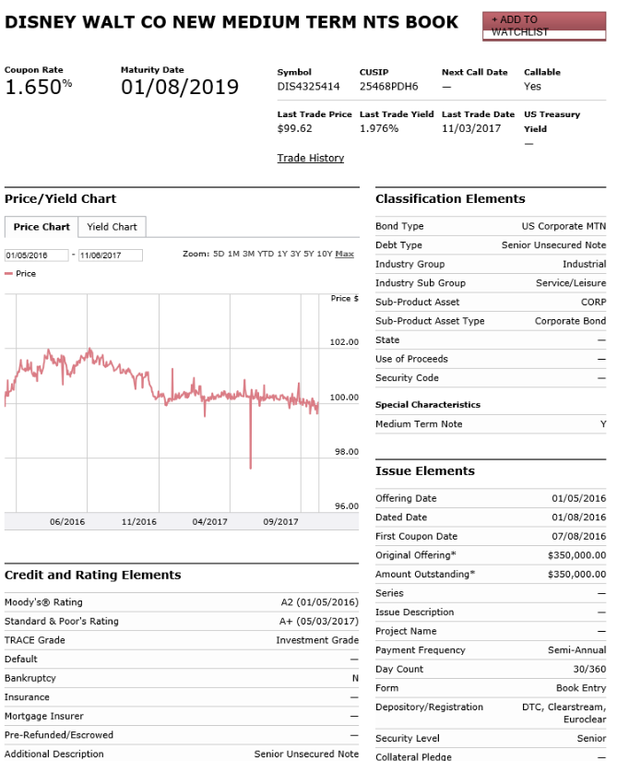
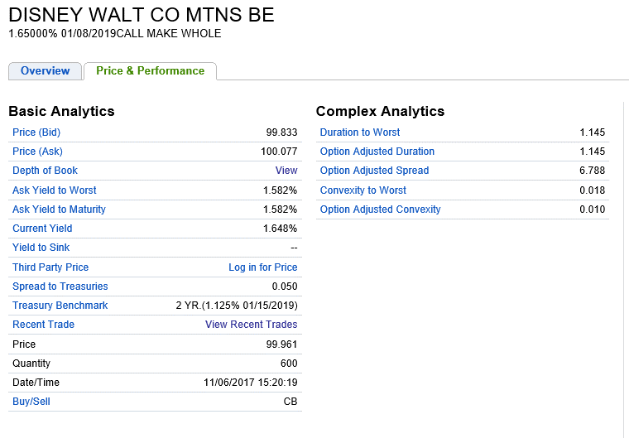
Bond Information
Bond prices are reported each day in the business press based on transactions that have occurred on the bond exchange. Formats differ across news outlets.
It is important to remember that the current price listed above is not reflected in DIS’ financial statements. Walt Disney Co. is not a part of the transaction when one investor sells his or her bond to another investor. For financial reporting purposes, DIS uses the market interest rate that existed when the bonds were first issued to the public.

Slide 15
Financial Reporting for Bonds
Principal (i.e., face value or maturity value)
Interest Rates (at time of issuance)
Stated rate determines cash payments
Market rate determines interest expense
Issue Price = Present Value (Interest Payments + Principal)
These two rates determine whether bonds are issued at par, a discount, or a premium
Discount rate = market interest rate at issuance date
PV of an annuity PV of a lump sum

Slide 16
Financial Reporting for Bonds
US GAAP and IFRS permit two financial reporting methods for bonds:
1. Amortized Cost Method
Net book value of bonds determined by the firm’s market interest rate on the date of issuance
Changes in the market interest rate after issuance DO NOT affect the book value of bonds on the balance sheet
Disclose the fair value of bonds (based on the market interest rate as of the balance sheet date) in the financial statement footnotes
Used by the majority of US firms
2. Fair Value Method
Bonds are reflected at their fair value on the balance sheet and changes in fair value each period are recognized on the income statement [ASC 825-10-35-4; IAS 39]

Slide 17
Stated Interest Rate vs. Market Interest Rate
Stated Interest Rate (i.e., coupon rate)
Rate stated on the face of the bond certificate
Used to compute cash payments each period
Set by the bond issuer at the bond issuance date
Market Interest Rate (i.e., yield to maturity (YTM))
Rate bondholders could obtain from an investment of similar risk
Used to compute bond issue price and interest expense each period
Set by the market at the bond issuance date

Slide 18
Cash Payments vs. Interest Expense
Cash Payment = Bond Face Value * Stated Rate at Issuance
Stated interest rate (set by the firm at the bond issuance date) determines cash payments
Same amount each period
Interest Expense = Bond Net Book Value * Market Rate at Issuance
Market interest rate (set by the market at the bond issuance date) determines interest expense recognized in the financial statement
Reflects the “true” interest rate the firm bears
If stated rate ≠ market rate, a different interest expense value is recognized each period

Slide 19
Bonds Issued at Par

Slide 20
Bonds Issued at Par
Example:
On January 1, 2016, Amazon issues $100,000 in bonds having a 10 percent annual stated rate of interest. The bonds mature in two years, and interest is paid semiannually. The market rate is 10 percent annually. Since the stated rate of interest is equal to the market rate of interest, these bonds are issued at par.
At the maturity date, December 31, 2017, the bond debt must be repaid, and the entry is a debit to Bonds Payable and a credit to Cash for $100,000.
To record the bond issue at par | Debit | Credit
Cash (+A) | $100,000
Bonds Payable (+L) |  | $100,000
To record bond interest every 6 months | Debit | Credit
Interest Expense (+E; -SE) | $5,000
Cash (-A) |  | $5,000

Slide 21
Bonds Issued at a Discount

Slide 22
Bonds Issued at a Discount
At issuance, Stated Interest Rate < Market Interest Rate
Investors demand a higher rate of return (given the risk of the investment) than the cash payments yield
Because cash payments are “too low,” investors bid down the bond’s price at issuance and purchase the bond for an amount less than face value
Discount = Issue Price - Face Value

Slide 23
Bonds Issued at Discount
Example:
On January 1, 2016, Amazon issues $100,000 in bonds having a 10 percent annual stated rate of interest. The bonds mature in two years, and interest is paid semiannually. The annual market rate of interest is 12 percent. Since the stated interest rate of 10 percent is less than the market interest rate of 12 percent, these bonds are issued at a discount.
These bonds are issued at a discount. Recall that the issue price of a bond is composed of the present value of two items: the principal (a single amount) and the interest (an annuity).
Market rate of 12 percent ÷ 2 interest periods per year = 6 percent
Bond term of 2 years × 2 periods per year = 4 periods
First, compute the present value of the principal
PV factor = 1 / (1+r)^{n}
PV factor = 1 / (1+6%)⁴
PV factor = 0.79209
Present Value = PV factor * Future Value
Present Value = 0.79209 * $100,000
Present Value = $79,209

Slide 24
Bonds Issued at Discount
Example:
On January 1, 2016, Amazon issues $100,000 in bonds having a 10 percent annual stated rate of interest. The bonds mature in two years, and interest is paid semiannually. The annual market rate of interest is 12 percent. Since the stated interest rate of 10 percent is less than the market interest rate of 12 percent, these bonds are issued at a discount.
These bonds are issued at a discount. Recall that the issue price of a bond is composed of the present value of two items: the principal (a single amount) and the interest (an annuity).
Market rate of 12 percent ÷ 2 interest periods per year = 6 percent
Bond term of 2 years × 2 periods per year = 4 periods
Now, let’s compute the present value of the interest
PVA factor = (1/r) * (1 - (1 / (1+r)^{n}))
PVA factor = (1/6%) * (1 - (1 / (1+6%)⁴))
PVA factor = 3.46511
Present Value = PV factor * Future Value
Present Value = 3.46511 * $5,000
Present Value = $17,326

Slide 25
Bonds Issued at Discount
Example:
On January 1, 2016, Amazon issues $100,000 in bonds having a 10 percent annual stated rate of interest. The bonds mature in two years, and interest is paid semiannually. The annual market rate of interest is 12 percent. Since the stated interest rate of 10 percent is less than the market interest rate of 12 percent, these bonds are issued at a discount.
These bonds are issued at a discount. Recall that the issue price of a bond is composed of the present value of two items: the principal (a single amount) and the interest (an annuity).
Market rate of 12 percent ÷ 2 interest periods per year = 6 percent
Bond term of 2 years × 2 periods per year = 4 periods
Finally, we can determine the issue price of the bonds by adding together the present value of the principal and the present value of the interest payments
Present Value of principal: $79,209
Present Value of interest: $17,326
Present Value of Bond: $96,535

Slide 26
Bonds Issued at Discount
Example:
On January 1, 2016, Amazon issues $100,000 in bonds having a 10 percent annual stated rate of interest. The bonds mature in two years, and interest is paid semiannually. The annual market rate of interest is 12 percent. Since the stated interest rate of 10 percent is less than the market interest rate of 12 percent, these bonds are issued at a discount.
*This is a contra-liability account that appears in the liability section of the balance sheet
The discount will be amortized over the two-year life of the bonds
To record the bond issue at discount | Debit | Credit
Cash (+A) | $96,535
Bond Discount* (+XL; -L) | 3,465
Bonds Payable (+L) |  | $100,000

Slide 27
Effective Interest Amortization
If you are using the effective-interest method (the theoretically preferred method), compute interest expense by multiplying the current unpaid balance and the market rate of interest. The discount amortization is the difference between the calculated interest expense and the cash paid (or accrued) for interest.
Step 1: Compute interest expense
Bonds Payable Book Value × Market Interest Rate per Period
Step 2: Compute cash owed for interest
Bond Face Value × Coupon Rate per Period
Step 3: Compute amortization amount
Interest Expense − Cash Owed for Interest

Slide 28
Bond Discount Amortization Schedule
Example:
On January 1, 2016, Amazon issues $100,000 in bonds having a 10 percent annual stated rate of interest. The bonds mature in two years, and interest is paid semiannually. The annual market rate of interest is 12 percent. Since the stated interest rate of 10 percent is less than the market interest rate of 12 percent, these bonds are issued at a discount.
Bond Discount Amortization Schedule
Date | Cash Owed for Interest | Interest Expense | Amortization of Bond Discount | Bonds Payable Book Value
 | $100,000 * 10% * ½ year | Beginning BV * 12% * ½ year | Cash Owed - Interest Expense | Beginning BV + Amortization
01/01/2016 |  |  |  | $96,535
06/30/2016 | $5,000 | $5,792 | $792 | $97,327
12/31/2016 | $5,000 | $5,840 | $840 | $98,167
06/30/2017 | $5,000 | $5,890 | $890 | $99,057
12/31/2017 | $5,000 | $5,943 | $943 | $100,000

Slide 29
Bonds Issued at Discount
Example:
On January 1, 2016, Amazon issues $100,000 in bonds having a 10 percent annual stated rate of interest. The bonds mature in two years, and interest is paid semiannually. The annual market rate of interest is 12 percent. Since the stated interest rate of 10 percent is less than the market interest rate of 12 percent, these bonds are issued at a discount.
*This is a contra-liability account that appears in the liability section of the balance sheet
To record the first interest payment | Debit | Credit
Interest Expense (+E; -SE) | $5,792
Bond Discount* (-XL; +L) |  | $ 792
Cash (-A) |  | 5,000

Slide 30
Bonds Issued at a Premium

Slide 31
Bonds Issued at a Premium
At issuance, Stated Interest Rate > Market Interest Rate
Investors demand a lower rate of return (given the risk of the investment) than the cash payments yield
Because cash payments are “too high,” investors bid up the bond’s price at issuance and purchase the bond for an amount greater than face value
Premium = Issue Price – Face Value

Slide 32
Bonds Issued at Premium
Example:
On January 1, 2016, Amazon issues $100,000 in bonds having a 10 percent annual stated rate of interest. The bonds mature in two years, and interest is paid semiannually. The annual market rate of interest is 8 percent. Since the stated interest rate of 10 percent is greater than the market interest rate of 8 percent, these bonds are issued at a premium.
These bonds are issued at a premium. Recall that the issue price of a bond is composed of the present value of two items: the principal (a single amount) and the interest (an annuity).
Market rate of 8 percent ÷ 2 interest periods per year = 4 percent
Bond term of 2 years × 2 periods per year = 4 periods
First, compute the present value of the principal
PV factor = 1 / (1+r)^{n}
PV factor = 1 / (1+4%)⁴
PV factor = 0.85480
Present Value = PV factor * Future Value
Present Value = 0.85480 * $100,000
Present Value = $85,480

Slide 33
Bonds Issued at Premium
Example:
On January 1, 2016, Amazon issues $100,000 in bonds having a 10 percent annual stated rate of interest. The bonds mature in two years, and interest is paid semiannually. The annual market rate of interest is 8 percent. Since the stated interest rate of 10 percent is greater than the market interest rate of 8 percent, these bonds are issued at a premium.
These bonds are issued at a premium. Recall that the issue price of a bond is composed of the present value of two items: the principal (a single amount) and the interest (an annuity).
Market rate of 8 percent ÷ 2 interest periods per year = 4 percent
Bond term of 2 years × 2 periods per year = 4 periods
Now, let’s compute the present value of the interest
PVA factor = (1/r) * (1 - (1 / (1+r)^{n}))
PVA factor = (1/4%) * (1 - (1 / (1+4%)⁴))
PVA factor = 3.62990
Present Value = PV factor * Future Value
Present Value = 3.62990 * $5,000
Present Value = $18,149

Slide 34
Bonds Issued at Premium
Example:
On January 1, 2016, Amazon issues $100,000 in bonds having a 10 percent annual stated rate of interest. The bonds mature in two years, and interest is paid semiannually. The annual market rate of interest is 8 percent. Since the stated interest rate of 10 percent is greater than the market interest rate of 8 percent, these bonds are issued at a premium.
These bonds are issued at a premium. Recall that the issue price of a bond is composed of the present value of two items: the principal (a single amount) and the interest (an annuity).
Market rate of 8 percent ÷ 2 interest periods per year = 4 percent
Bond term of 2 years × 2 periods per year = 4 periods
Finally, we can determine the issue price of the bonds by adding together the present value of the principal and the present value of the interest payments
Present Value of principal: $ 85,480
Present Value of interest: $ 18,149
Present Value of Bond: $103,629

Slide 35
Bonds Issued at Premium
Example:
On January 1, 2016, Amazon issues $100,000 in bonds having a 10 percent annual stated rate of interest. The bonds mature in two years, and interest is paid semiannually. The annual market rate of interest is 8 percent. Since the stated interest rate of 10 percent is greater than the market interest rate of 8 percent, these bonds are issued at a premium.
*This is a contra-liability account that appears in the liability section of the balance sheet
The premium will be amortized over the two-year life of the bonds
To record the bond issue at premium | Debit | Credit
Cash (+A) | $103,629
Bond Premium* (+XL; +L) |  | $ 3,629
Bonds Payable (+L) |  | $100,000

Slide 36
Bond Premium Amortization Schedule
Example:
On January 1, 2016, Amazon issues $100,000 in bonds having a 10 percent annual stated rate of interest. The bonds mature in two years, and interest is paid semiannually. The annual market rate of interest is 8 percent. Since the stated interest rate of 10 percent is greater than the market interest rate of 8 percent, these bonds are issued at a premium.
Bond Premium Amortization Schedule
Date | Cash Owed for Interest | Interest Expense | Amortization of Bond Premium | Bonds Payable Book Value
 | $100,000 * 10% * ½ year | Beginning BV * 8% * ½ year | Interest Expense - Cash Owed | Beginning BV + Amortization
01/01/2016 |  |  |  | $103,629
06/30/2016 | $5,000 | $4,145 | ($855) | $102,775
12/31/2016 | $5,000 | $4,111 | ($889) | $101,886
06/30/2017 | $5,000 | $4,075 | ($925) | $100,961
12/31/2017 | $5,000 | $4,038 | ($962) | $100,000

Slide 37
Bonds Issued at Premium
Example:
On January 1, 2016, Amazon issues $100,000 in bonds having a 10 percent annual stated rate of interest. The bonds mature in two years, and interest is paid semiannually. The annual market rate of interest is 8 percent. Since the stated interest rate of 10 percent is greater than the market interest rate of 8 percent, these bonds are issued at a premium.
*This is a contra-liability account that appears in the liability section of the balance sheet
To record the first interest payment | Debit | Credit
Interest Expense (+E; -SE) | $4,145
Bond Premium* (-XL; -L) | 855
Cash (-A) |  | $5,000

Slide 38
Early Redemption of Bonds

Slide 39
Early Redemption of Bonds
Bonds are normally issued for long periods (i.e., 20 or 30 years). However, a corporation may decide to retire a bond before its maturity date if the bond has a call feature.
When a bond does not have a call feature, a company may elect to retire debt early by purchasing it on the open market, just as an investor would. This might be an attractive approach if the price of the bond fell after the date of issue. What could cause the price of a bond to fall? The most common cause is a rise in interest rates.
Bond prices move in the opposite direction of interest rates. If interest rates go up, bond prices fall, and vice versa. When interest rates have gone up, a company that wants to retire a bond before maturity may find that buying the bond on the open market is less expensive than paying a call premium.
Gains and losses are calculated by comparing the cash paid to retire bonds with the book value of the bonds.
If the book value is greater than the cash paid to retire bonds, a gain is recorded.
If the book value is less than the cash paid to retire bonds, a loss is recorded.

Slide 40
Early Redemption: Bond Issued at Discount
Example:
On January 1, 2016, Amazon issues $100,000 in bonds having a 10 percent annual stated rate of interest. The bonds mature in two years, and interest is paid semiannually. The annual market rate of interest is 12 percent. Since the stated interest rate of 10 percent is less than the market interest rate of 12 percent, these bonds are issued at a discount.
Suppose Amazon decides to redeem its bonds on 01/01/2017 when its market interest rate is 15%
Bond Discount Amortization Schedule
Date | Cash Owed for Interest | Interest Expense | Amortization of Bond Discount | Bonds Payable Book Value
 | $100,000 * 10% * ½ year | Beginning BV * 12% * ½ year | Cash Owed - Interest Expense | Beginning BV + Amortization
01/01/2016 |  |  |  | $96,535
06/30/2016 | $5,000 | $5,792 | $792 | $97,327
12/31/2016 | $5,000 | $5,840 | $840 | $98,167
06/30/2017 | $5,000 | $5,890 | $890 | $99,057
12/31/2017 | $5,000 | $5,943 | $943 | $100,000

Slide 41
Early Redemption: Bond Issued at Discount
Example:
On January 1, 2016, Amazon issues $100,000 in bonds having a 10 percent annual stated rate of interest. The bonds mature in two years, and interest is paid semiannually. The annual market rate of interest is 12 percent. Since the stated interest rate of 10 percent is less than the market interest rate of 12 percent, these bonds are issued at a discount.
Suppose Amazon decides to redeem its bonds on 01/01/2017 when its market interest rate is 15%
According to the above example, has Amazon become more or less risky in the past year?
To record bond redemption | Debit | Credit
Bond Payable (-L) | $100,000
Bond Discount (-XL; +L) |  | $ 1,833
Cash (-A) |  | 95,511
Gain on Bond Redemption (+G; +SE) |  | 2,656

Slide 42
Zero Coupon Bonds

Slide 43
Zero Coupon Bonds
Corporations may issue bonds with unusual features, too. For example, a corporation might issue a bond where all of the interest is paid at the bond maturity date. No semi-annual cash interest payments are paid out, so no stated interest rate. These bonds are often called zero coupon bonds.
Do you think these bonds will be sold at par, a discount, or a premium?
The coupon interest rate on a bond can be virtually any amount, and the price of the bond will be adjusted so that investors earn the market rate of interest. A bond with a zero coupon interest rate is simply a deeply discounted bond that will sell for substantially less than its maturity value.
For financial reporting purposes, the firm still accrues interest expense each period even though no cash is paid.
 | Debit | Credit
Interest Expense (+E; -SE) | XX
Bond Discount (+XL; +L) |  | XX

Slide 44
Zero Coupon Bond Amortization Schedule
Example:
Firm Y issues $100,000 of zero coupon, 3-year bonds on 01/01/2016 when its market interest rate is 8%. Financial statements are prepared semi-annually. Prepare Firm Y’s bond amortization schedule.
Zero Coupon Bond Amortization Schedule
Date | Cash Owed for Interest | Interest Expense | Discount | Net Book Value
01/01/2016 | - | - | $20,969 | $79,031
06/30/2016 | $0 | $3,161 | ($3,161) | $82,192
12/31/2016 | $0 | $3,288 | ($3,288) | $85,480
06/30/2017 | $0 | $3,419 | ($3,419) | $88,899
12/31/2017 | $0 | $3,556 | ($3,556) | $92,455
06/30/2018 | $0 | $3,698 | ($3,698) | $96,153
12/31/2018 | $0 | $3,847 | ($3,847) | $100,000
12/31/2018 | $100,000 | $0 | $0 | $0

Slide 45
Summary: Financial Reporting for Bonds
Firms amortize the bond discount/premium at each interest accrual date
At the bond maturity date, net book value = face value
Bonds Net Book Value Issued at a Premium
$103,629
Net Book Value of Debt Decreases
as Premium is Amortized
Bond Net Book Value
Issued at Par
$100,000
$100,000 Principal
Net Book Value of Debt Increases
as Discount is Amortized
Bond Net Book Value
Issued at a Discount
$96,535

Slide 46
Bonds Payable: Statement of Cash Flows
The issuance of a bond payable is reported as a cash inflow from financing activities on the statement of cash flows. The repayment of principal is reported as a cash outflow from financing activities.
Interest expense is reported on the income statement and is directly related to the computation of net income. As a result, U.S. GAAP requires that interest payments be reported in the cash flows from operating activities section of the statement. Companies are also required to report the amount of cash paid for interest expense each accounting period.

Slide 47
Ratio Analysis

Slide 48
Times Interest Earned
How effectively is management utilizing its debt?
The times interest earned ratio shows the amount of resources generated for each dollar of interest expense. In general, a high ratio is viewed more favorably than a low ratio.
The times interest earned ratio is often misleading for new or rapidly growing companies, which tend to invest considerable resources to build their capacity for future operations. In such cases, the times interest earned ratio will reflect significant amounts of interest expense associated with the new capacity but not the income that will be earned with the new capacity.
Analysts should consider the company’s long-term strategy when using this ratio. Some analysts prefer to compare interest expense to the amount of cash a company can generate. Because creditors cannot be paid with “income” that is generated, they must be paid with cash.
Net Income + Interest Expense + Income Tax Expense
Interest Expense
=
Times Interest Earned

Slide 49
Debt-to-Equity
What is the firm’s capital structure?
This ratio shows the relationship between the amount of capital provided by owners and the amount provided by creditors. In general, a high ratio suggests that a company relies heavily on funds provided by creditors.
Heavy reliance on creditors increases the risk that a company may not be able to meet its contractual financial obligations during a business downturn.
The debt-to-equity ratio tells only part of the story with respect to the risks associated with debt. It does not help the analyst understand whether the company’s operations can support its debt. Remember that debt carries an obligation to make cash payments for interest and principal. As a result, most analysts would evaluate the debt-to-equity ratio within the context of the amount of cash the company can generate from operating activities.
Total Liabilities
Stockholders’ Equity
Debt-to-Equity
=

Slide 50
End of Chapter 10

